Slide 1
IBM Data Science Capstone Covid-19 in Iran
By : ZAHRA ZANDESH

Slide 2
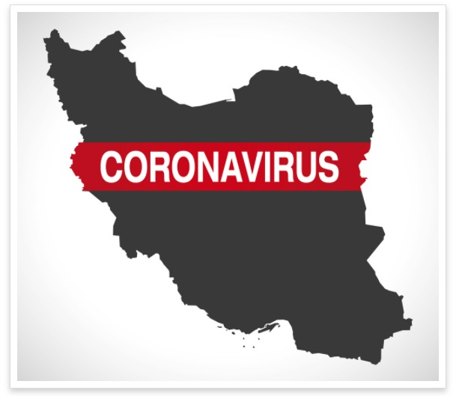

Slide 3
IBM Data Science Capstone IRAN
Iran, also called Persia, and officially the Islamic Republic of Iran, is a country in Western Asia. It is bordered to the northwest by Armenia and Azerbaijan to the north by the Caspian Sea, to the northeast by Turkmenistan, to the east by Afghanistan, to the southeast by Pakistan, to the south by the Persian Gulf and the Gulf of Oman, and to the west by Turkey and Iraq. Iran covers an area of 1,648,195 km2 (636,372 sq mi), with a population of 83 million. It is the second-largest country in the Middle East, and its capital and largest city is Tehran.
Iran is home to one of the world's oldest civilizations, beginning with the formation of the Elamite kingdoms in the fourth millennium BC. It was first unified by the Iranian Medes in the seventh century BC and reached its territorial height in the sixth century BC, when Cyrus the Great founded the Achaemenes Empire, which became one of the largest empires in history and the world's first superpower.

Slide 4
IBM Data Science Capstone Covid-19
COVID-19 affects different people in different ways. Infected people have had a wide range of symptoms reported – from mild symptoms to severe illness.
Symptoms may appear 2-14 days after exposure to the virus. People with these symptoms may have COVID-19:
Fever or chills
Cough
Shortness of breath or difficulty breathing
Fatigue
Muscle or body aches
Headache
New loss of taste or smell
Sore throat
Congestion or runny nose
Nausea or vomiting
Diarrhea

Slide 5
IBM Data Science Capstone Covid-19 in Iran
The COVID-19 pandemic in Iran is part of the worldwide pandemic of coronavirus disease 2019 (COVID-19) caused by severe acute respiratory syndrome coronavirus . On 19 February 2020, Iran reported its first confirmed cases of infections in Qom. The virus may have been brought to the country by a merchant from Qom who had travelled to China.
In response to the coronavirus the government cancelled public events and Friday prayers; closed schools, universities, shopping centers, bazaars, and holy shrines; and banned festival celebrations. Economic measures were also announced to help families and businesses, and the pandemic is credited with compelling the government to make an unprecedented request for an emergency loan of five billion US dollars from the International Monetary Fund
The government initially rejected plans to quarantine entire cities and areas, and heavy traffic between cities continued ahead of Nowruz, despite the government's intention to limit travel. The government later announced a ban on travel between cities following an increase in the number of new cases.
Government restrictions were gradually eased starting in April. The number of new cases fell to a low on 2 May, but increased again in May as restrictions were eased, with a new peak of cases reported on 4 June, and new peaks in the number of deaths reported in July.

Slide 6
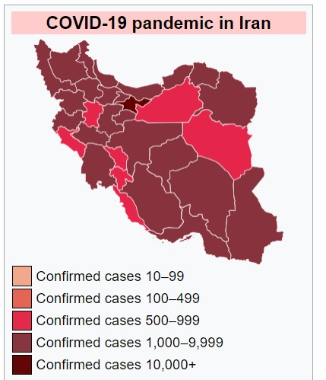

Slide 7
IBM Data Science Capstone Covid-19 in Iran
With a new victim of the coronavirus dying every two minutes, deaths are soaring in Iran, with infections from the new Delta variant skyrocketing and hospitals overfilled.
There are also widespread shortages of oxygen cylinders and other materials as many Iranians are furious with their leaders over a vaccination campaign that lags far behind other countries.

Slide 8
IBM Data Science Capstone Business problem
Iran is facing its worst surge in the virus to date — a record number of deaths and infections per day with nearly 4.2 million COVID-19 patients across the country, and a healthcare system near collapse.
With a new victim of the coronavirus dying every two minutes, deaths are soaring in Iran, with infections from the new Delta variant skyrocketing and hospitals overfilled.
There are also widespread shortages of oxygen cylinders and other materials as many Iranians are furious with their leaders over a vaccination campaign that lags far behind other countries.

Slide 9
The Questions which I aim to answer in this project are the following:
Different cities have different shortages and need different services and outfits like below:
oxygen cylinders
Medical devices
Medical materials and equipment's
vaccine distribution
1- which city has the best situation in vaccination?
2- in the given neighborhood is there any good health care services
Like vaccination service is available ?
3- which city has the worst situation in vaccination?

Slide 10
Data Used
Bangalore district pin code from the site https://coronavirus.jhu.edu/region/iran
After using the geocoding API, we will create latitudes and longitudes for the given addresses.
Foursquare API Data:
We will need data about different venues in different neighborhoods of that specific borough. In order to gain that information we will use "Foursquare" locational information. Foursquare is a location data provider with information about all manner of venues and events within an area of interest. Such information includes venue names, locations, menus and even photos. As such, the foursquare location platform will be used as the sole data source since all the stated required information can be obtained through the API.

Slide 11
Methodology
First, we scrape the data using BeautifulSoup.
Second, we find the latitudes and longitudes of the given addresses(using Gmaps geocoding API)
Third, we will plot those coordinates using the folium map.
Fourth, We will find the number of collisions in the given dataset.
Fifth, Using the dataset, we will use FourSquare API for finding the places resided near to those pin codes and merge with the original dataset
Sixth, To use this dataset for predicting the most common venue, we have to use one-hot encoding for K-means Clustering algorithm.
Seventh, Using the silhouette score, we will find the best K-value for our most common venue prediction.
At last, Using the K-value, we will find the cluster labels for each an every place and last we will plot the map and find the most common venue point in the selective district.

Slide 12
Thank You
Zahra Zandesh

